Slide 1
AUREX · BCCL’S SECURE AI WORKSPACE
Reading data
A working method for getting from a spreadsheet you did not build
to a number you would defend in front of your MD.
DISHANT SINGLA
₹110 Cr
1 Bn+
200 M
120 M
B.Tech, IIT Roorkee 2015 · Founder, Base42 Systems
ad business on the
platform I built
ad impressions
a month
monthly active
users
Ola customer
profiles built
Tuesday 4 August 2026 · 2:30–4:30 PM IST · Live, hands-on · Bring a laptop

Slide 2
WHO IS RUNNING THIS SESSION
I have spent eight years building
the systems these numbers come out of.
AT SCALE
₹110 Cr
ad revenue running on the platform
1 Bn+
Ola, Koo, Khatabook, Wealthy, HT Media. Customer data platforms, identity resolution, recommendation systems, ad targeting. Most recently the central data platform at HT Digital Streams, sitting under a ₹110 crore a year ad business.
ad impressions a month
200 M
monthly active users
120 M
Every trap in this session is one I have shipped, been burned by, or caught in review. That is the only reason it is in here.
Ola customer profiles built
₹2.5 Cr
a year in retired tooling
60%
duplicate IDs eliminated
02

Slide 3
Why a company pays for this
The gap between a number that survives scrutiny and one that does not
The number nobody checked
WHAT CHANGES AFTER TODAY
A board pack goes out with a metric computed on the wrong date column. Three months of decisions get anchored to it.
Open a file you have never seen. Work out what it actually contains. Ask it eight questions that surface something. Then put a number in front of a decision-maker with the caveat already attached.
None of that needs Excel skill or statistics training. It needs the sequence, and it needs to know where numbers go wrong.
The definition nobody agreed
Two teams present revenue in the same meeting, ₹40 Cr apart. Both are right. Nobody knows that yet.
The trend that was three accounts
A segment is declared a growth engine. One client churns and the growth engine goes with it.
Aurex does the execution.
You do the judgement.
03

Slide 4
Five frameworks, one file, and the cards to run them again
Everything in this session is designed to be reusable on Monday
01
02
03
04
05
THE SEVEN-STEP READ
THE EIGHT LENSES
THE CHART SELECTOR
THE SIX DISTORTIONS
THE FIVE-CHECK GATE
The sequence for any unfamiliar file
Every question a dataset can answer
Say the comparison, get the chart
Where confident numbers go wrong
What to verify before you send
YOU ALSO LEAVE WITH
The practice file
Eight prompts
The gate card
3,079 rows of real-shaped ad bookings, traps included
One per lens, written to force checkable output
Five checks, one page, stick it on your monitor
04

Slide 5
One file. Every framework runs on it.
ad-sales-data.csv · three years of advertising bookings, 2022 to 2024
3,079
14
8
2,490
₹44.8 Cr
rows
columns
cities
confirmed bookings
net revenue
WHAT IS IN IT
Dates
booked and published
Cities
8 Indian metros
Editions
4 publications
Ad types
Display, Digital, Classified, and two more
Categories
10 advertiser sectors
Reps
30 salespeople
Money
rate, discount, gross, net
Status
confirmed, cancelled, pending
It carries four planted data-quality faults. Finding them is Step 2.
05

Slide 6
MODULE 1 · THE SEVEN-STEP READ
MODULE 1 OF 5
01
The Seven-Step Read
Analysts do not start with the numbers. They start with the decision,
then the shape of the file, and only then the arithmetic.
STEPS 1 TO 7 · 25 MINUTES
06

Slide 7
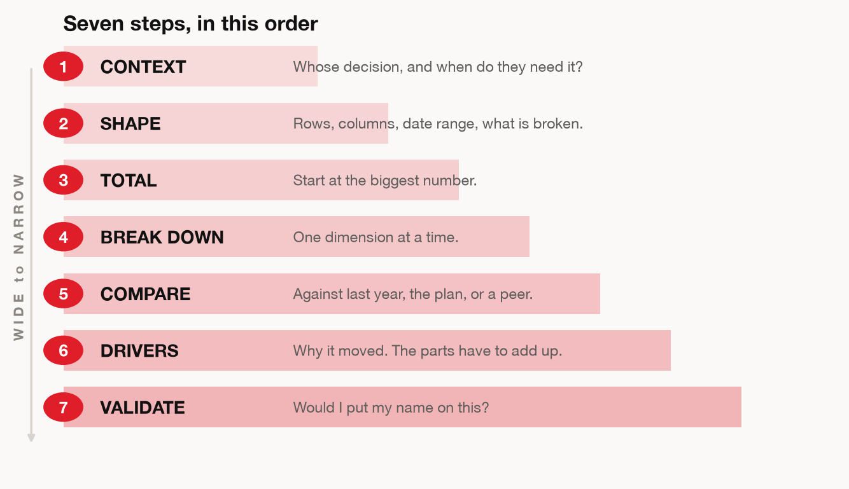
THE FRAMEWORK
MODULE 1 · THE SEVEN-STEP READ
07

Slide 8
MODULE 1 · THE SEVEN-STEP READ
Step 1 — CONTEXT: three questions before the file opens
Most weak analysis is a correct answer to a question nobody had.
1
Who decides, and when?
If you cannot name the person and the date, you are producing trivia.
2
Which answer would change the decision?
If every possible finding leads to the same action, do not run the analysis.
3
What is the smallest version you could answer today?
One metric, one dimension, one period. Widen later if it earns it.
08

Slide 9
MODULE 1 · THE SEVEN-STEP READ
What Step 1 sounds like in practice
Same file, same tool, two different opening moves
WITHOUT A FRAME
WITH A FRAME
“Analyse this file.”
“Which two cities should lose
headcount next quarter?”
Revenue rose 4.3%
8 cities represented
3,079 rows
Q3 shows a dip
Average deal ₹1.8 lakh
One table
Revenue per rep, by city
Two cities named
A caveat about deal mix
All of it true. None of it usable.
One question, and the file has a job.
09

Slide 10
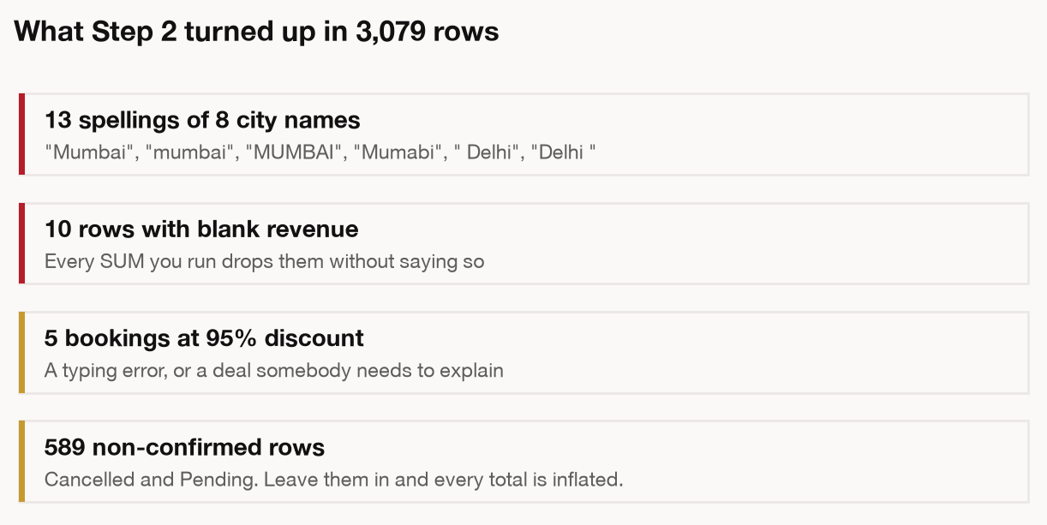
STEP 2 — SHAPE: WHAT DID THE FILE ACTUALLY ARRIVE AS
MODULE 1 · THE SEVEN-STEP READ
10

Slide 11
MODULE 1 · THE SEVEN-STEP READ
WAR STORY · HT DIGITAL STREAMS · IDENTITY RESOLUTION
We were counting the same person up to four times.
60%
of duplicate IDs eliminated once the grain was defined once, centrally
Three sites and a set of APIs, each minting its own user ID. Every audience number the business planned against was inflated, and nobody could see it, because each system was internally consistent.
The fix was not analytical. It was going back to what one row meant, across four systems that had each quietly decided for themselves.
Step 2 exists because “what is one row?” is the question that was never asked.
11

Slide 12
MODULE 1 · THE SEVEN-STEP READ
Spend the first two minutes
on what the file is.
Somebody filtered it, named the columns and decided what to leave out before it reached you. Those decisions are now your assumptions, whether you look at them or not.
12

Slide 13
MODULE 2 · THE EIGHT LENSES
MODULE 2 OF 5
02
The Eight Lenses
Almost every question you will be handed is one of these eight.
Naming the lens tells you the cut, the chart, and the trap to check.
LENSES 1 TO 8 · 40 MINUTES
13

Slide 14
MODULE 2 · THE EIGHT LENSES
The Eight Lenses, on one page
The reference artefact for this module. Photograph this slide.
LENS
THE QUESTION
THE CUT
THE TRAP IT HIDES
1 Comparison
How does this stack up against that?
Total by dimension, sorted
Counts where rates belong
2 Ranking
Who is on top, who is at the bottom?
Sort both ends, not just the top
A top-10 list with no bottom
3 Trend
What changed, and when exactly?
Index to a common base
Two scales on one chart
4 Composition
What makes up the whole?
Share of total, by period
Mix shift read as performance
5 Distribution
What does a typical one look like?
Histogram, plus the median
The mean quoted as typical
6 Correlation
Do these move together?
Scatter, then a coefficient
Correlation stated as cause
7 Outliers
What looks wrong?
Flag against the median
Concentration read as a trend
8 Decomposition
Why did the number move?
Bridge that sums to the total
A residual nobody names
14

Slide 15
LENS 1 OF 8
MODULE 2 · THE EIGHT LENSES
1
COMPARISON
THE QUESTION IT ANSWERS
ON TODAY’S FILE
THE TRAP IT HIDES
How does this one stack up against that one?
Which city bills the most ad revenue?
Mumbai is biggest at everything. Biggest is not the same as best.
Next: the same lens run on 2,490 confirmed bookings.
15

Slide 16
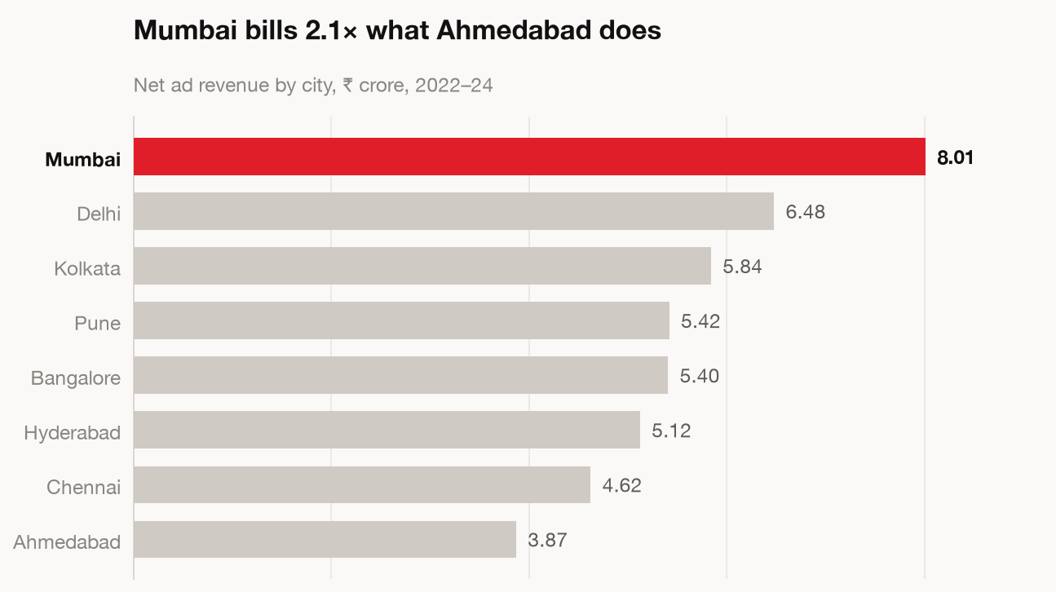
LENS 1 · COMPARISON
MODULE 2 · THE EIGHT LENSES
Sorted, one colour on the point, numbers on the bars. You will reach for this shape more than any other.
16

Slide 17
MODULE 2 · THE EIGHT LENSES
The prompt behind Lens 1
Paste this, do not type it. The wording is the lesson.
Using the code interpreter on ad-sales-data.csv:
Filter to status = Confirmed and drop rows
where net_amount is blank. Tell me how many
rows you dropped.
The city column has spelling variants. Show me
the mapping you intend to apply before you
apply it.
Then total net_amount by city, sorted high
to low. Give me the gap between top and
bottom as a multiple, not just two numbers.
Return a horizontal bar chart, sorted, one
accent colour, values on the bars, titled with
the finding as a sentence.
WHAT COMES BACK
A sorted bar chart, titled with the finding
A cleaning log: 13 city strings collapsed to 8
The row count it dropped, stated up front
The gap as “2.1×”, not as two raw numbers
17

Slide 18
LENS 2 OF 8
MODULE 2 · THE EIGHT LENSES
2
RANKING
THE QUESTION IT ANSWERS
ON TODAY’S FILE
THE TRAP IT HIDES
Who is on top, and who is at the bottom?
Which reps carry the business, and which coast?
A top-10 list flatters. The bottom is where the recoverable money sits.
Next: the same lens run on 2,490 confirmed bookings.
18

Slide 19
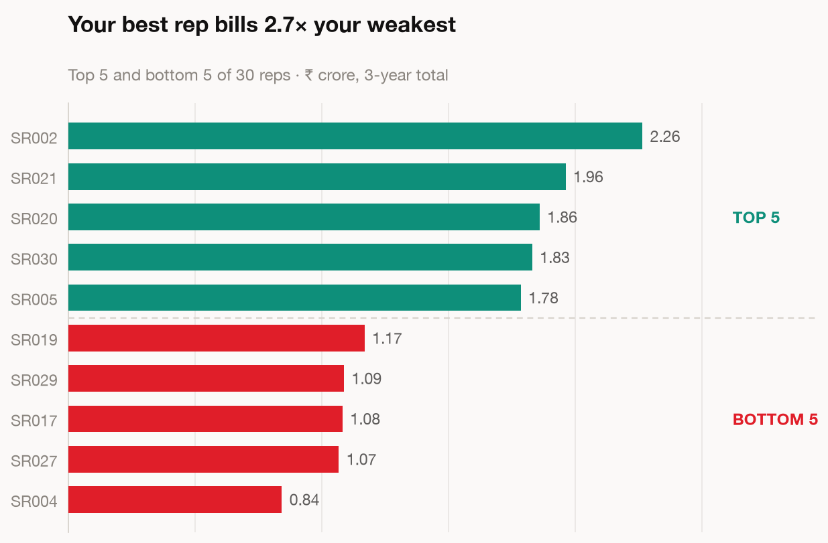
LENS 2 · RANKING
MODULE 2 · THE EIGHT LENSES
Show both ends. A top-5 on its own hides the gap you can actually do something about.
19

Slide 20
LENS 3 OF 8
MODULE 2 · THE EIGHT LENSES
3
TREND
THE QUESTION IT ANSWERS
ON TODAY’S FILE
THE TRAP IT HIDES
What changed over time, and when exactly?
Is digital really growing, or does it just feel that way?
Raw lines let the biggest series bury every other story.
Next: the same lens run on 2,490 confirmed bookings.
20

Slide 21
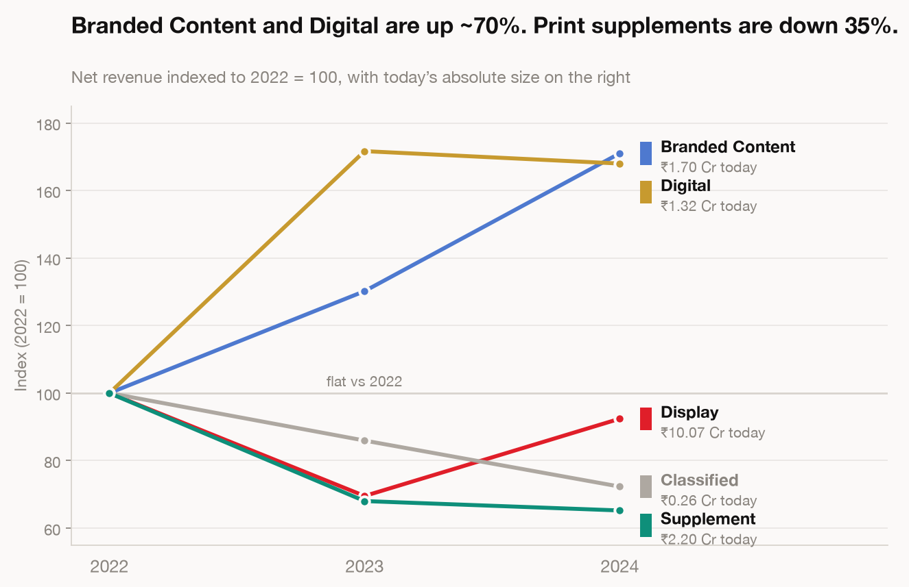
LENS 3 · TREND
MODULE 2 · THE EIGHT LENSES
Indexed to 2022 = 100. When one series is 40× another, plotting raw values shows you the big line and nothing else.
21

Slide 22
LENS 4 OF 8
MODULE 2 · THE EIGHT LENSES
4
COMPOSITION
THE QUESTION IT ANSWERS
ON TODAY’S FILE
THE TRAP IT HIDES
What makes up the total, and is the mix moving?
Print is shrinking. By how much, and into what?
Volume can rise while revenue stalls. That is mix, not performance.
Next: the same lens run on 2,490 confirmed bookings.
22

Slide 23
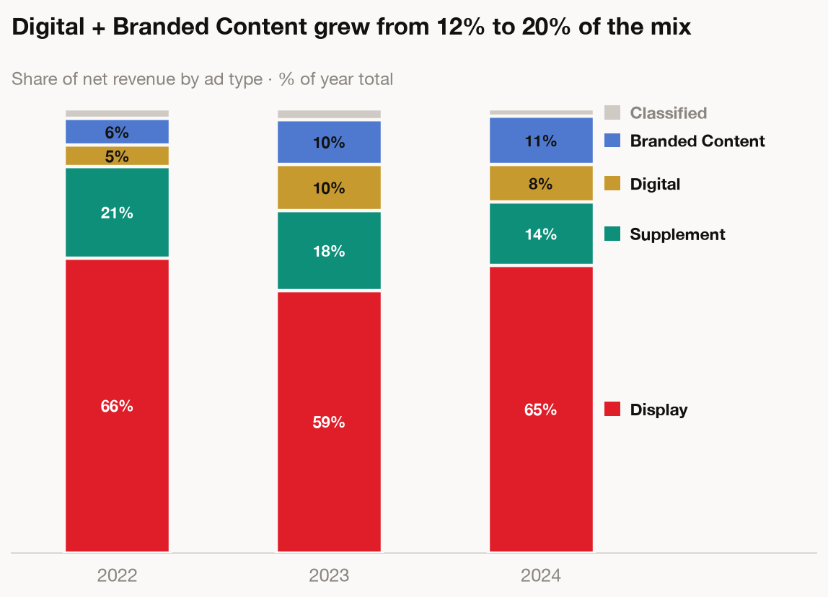
LENS 4 · COMPOSITION
MODULE 2 · THE EIGHT LENSES
Mix shift lives here. More of what sold was the cheap thing, so pages went up and money did not.
23

Slide 24
LENS 5 OF 8
MODULE 2 · THE EIGHT LENSES
5
DISTRIBUTION
THE QUESTION IT ANSWERS
ON TODAY’S FILE
THE TRAP IT HIDES
What does a typical one actually look like?
What is a normal deal size here?
A handful of whales drag the average away from reality.
Next: the same lens run on 2,490 confirmed bookings.
24

Slide 25
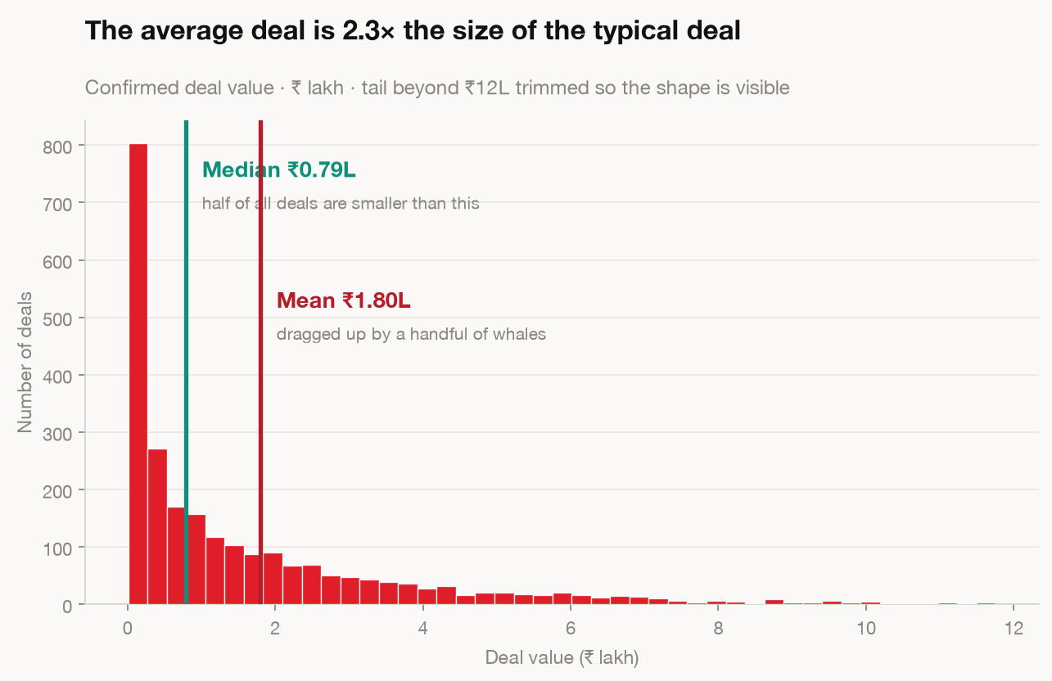
LENS 5 · DISTRIBUTION
MODULE 2 · THE EIGHT LENSES
Mean ₹1.80L, median ₹0.79L. Call the mean “typical” in a meeting and you are overstating by 2.3×.
25

Slide 26
LENS 6 OF 8
MODULE 2 · THE EIGHT LENSES
6
CORRELATION
THE QUESTION IT ANSWERS
ON TODAY’S FILE
THE TRAP IT HIDES
Do these two things move together?
Do bigger discounts actually win bigger deals?
Two things moving together is not one causing the other.
Next: the same lens run on 2,490 confirmed bookings.
26

Slide 27
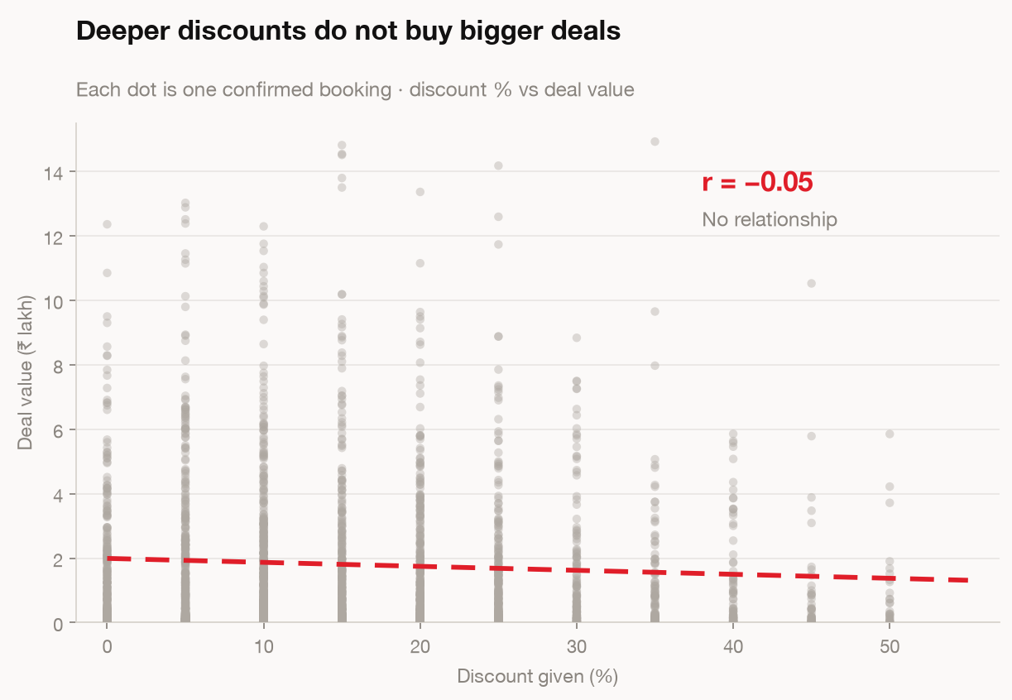
LENS 6 · CORRELATION
MODULE 2 · THE EIGHT LENSES
r = −0.05, so there is nothing here. That is still a result, and it is the one that settles a discount argument.
27

Slide 28
LENS 7 OF 8
MODULE 2 · THE EIGHT LENSES
7
OUTLIERS
THE QUESTION IT ANSWERS
ON TODAY’S FILE
THE TRAP IT HIDES
What looks wrong, and is it real or a data error?
Are a handful of deals carrying the whole year?
A few large deals can manufacture a trend that does not exist.
Next: the same lens run on 2,490 confirmed bookings.
28

Slide 29
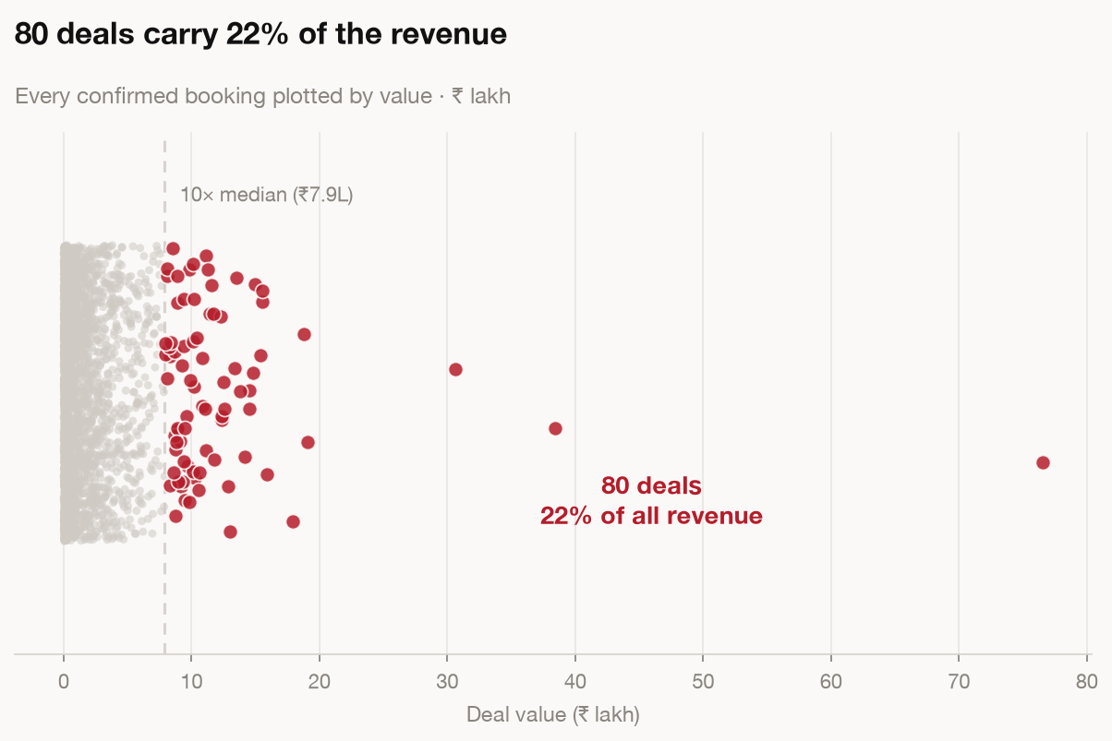
LENS 7 · OUTLIERS
MODULE 2 · THE EIGHT LENSES
80 deals out of 2,490 carry 22% of revenue. Lose two of them and the trend you were describing goes away.
29

Slide 30
LENS 8 OF 8
MODULE 2 · THE EIGHT LENSES
8
DECOMPOSITION
THE QUESTION IT ANSWERS
ON TODAY’S FILE
THE TRAP IT HIDES
Why did the number move?
Revenue grew 21%. More deals, or bigger ones?
“It went up” is not a driver. Parts that do not sum are not an answer.
Next: the same lens run on 2,490 confirmed bookings.
30

Slide 31
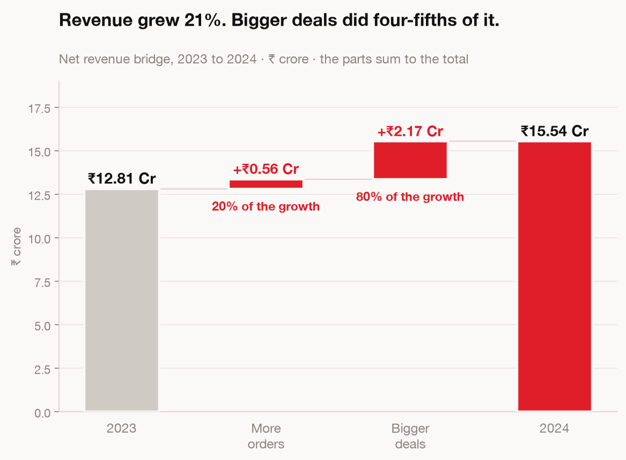
LENS 8 · DECOMPOSITION
MODULE 2 · THE EIGHT LENSES
The parts have to sum to the whole. An unexplained residual means you do not understand the movement yet.
31

Slide 32
MODULE 2 · THE EIGHT LENSES
The prompt behind Lens 8
Paste this, do not type it. The wording is the lesson.
Net revenue moved from ₹12.81 Cr in 2023 to
₹15.54 Cr in 2024. Find out why, with code.
1 Confirm the total change, absolute and %.
2 Split it into two effects:
volume = (orders24 − orders23) × avg23
deal size = (avg24 − avg23) × orders24
3 The two must sum to the total change.
Print the reconciliation and the residual.
If the residual is not about zero, stop and
tell me what is unexplained.
4 Label every driver OBSERVED or INFERRED.
WHAT COMES BACK
A bridge where the parts tie to the total
20% from more orders, 80% from bigger ones
The residual, printed, at about zero
An honest label on anything it assumed
32

Slide 33
MODULE 2 · THE EIGHT LENSES
WAR STORY · HT DIGITAL STREAMS · CONTEXTUAL TARGETING
The lift was real. The first number we ran was not.
+25%
CTR and conversion against vanilla targeting, on a like-for-like cut
We moved from broad targeting to in-page semantics with brand-safety controls. The early read looked enormous, because the two groups were not comparable. Different placements, different weeks, different mix.
Once it was cut properly against a like-for-like baseline, the gain held up. Smaller than the first number, and defensible in front of a client.
Lens 1 is the whole discipline: a number means nothing until you name what it is compared to.
33

Slide 34
MODULE 2 · THE EIGHT LENSES
Most people stop at
“revenue went up.”
Lenses 6 to 8 are the ones that get skipped, and the ones that get you invited back into the room.
34

Slide 35
MODULE 2 · THE EIGHT LENSES
HANDS-ON · 12 MIN
Open ad-sales-data.csv in Aurex.
Pick any two lenses and run them properly.
Write down which trap you checked for.
Post in chat: “The one thing that surprised you most”
35

Slide 36
MODULE 3 · THE CHART SELECTOR
MODULE 3 OF 5
03
The Chart Selector
Nine comparisons, nine answers. Name the comparison out loud
and the chart stops being a matter of taste.
15 MINUTES
36

Slide 37
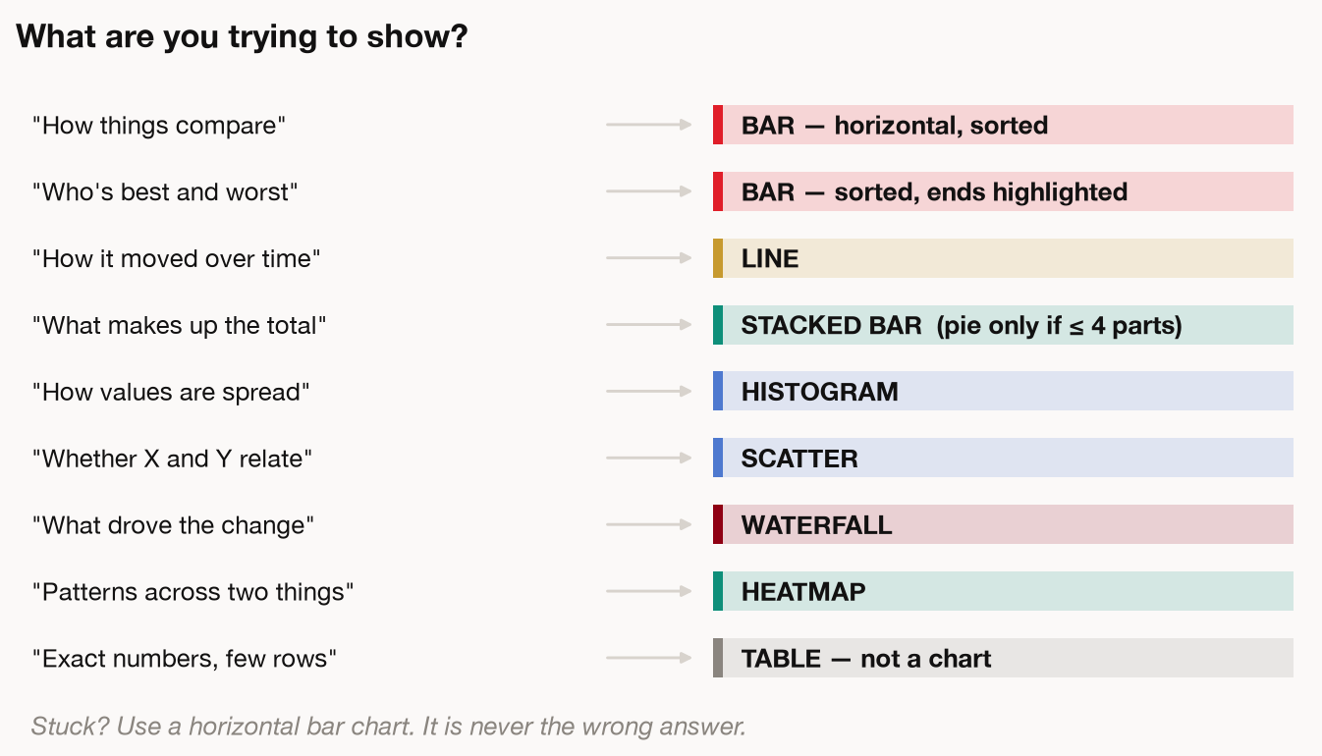
THE SELECTOR
MODULE 3 · THE CHART SELECTOR
37

Slide 38
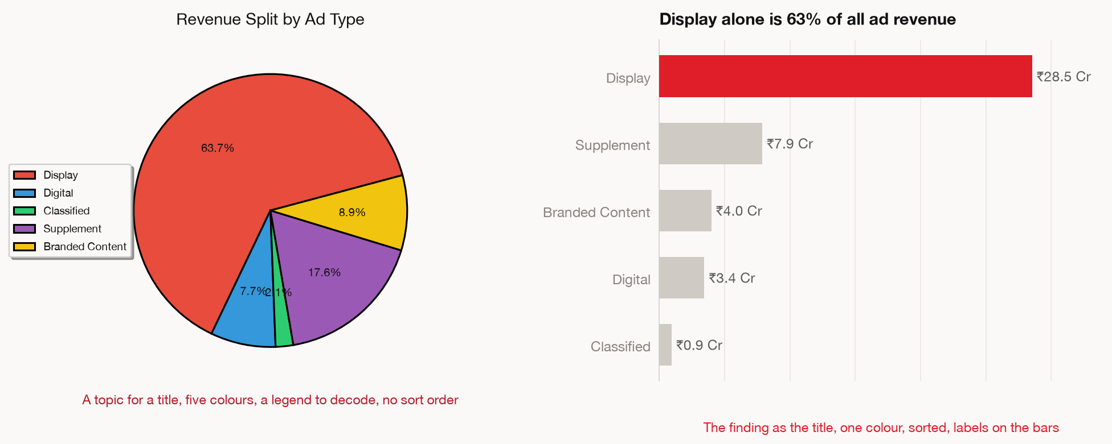
THE SAME NUMBERS, TWICE
MODULE 3 · THE CHART SELECTOR
38

Slide 39
MODULE 3 · THE CHART SELECTOR
Three rules that fix almost every chart
Then point at anything still on the chart and ask what it proves. If it does not support the title, take it off.
1
Put the finding in the title
“Display is 63% of revenue”, never “Revenue by Ad Type”.
2
One colour carries the point
Everything else goes grey. Colour is an argument, not decoration.
3
Label the bars, delete the furniture
Legend, gridlines, border, markers. All of it competes with the data.
39

Slide 40
MODULE 4 · THE SIX DISTORTIONS
MODULE 4 OF 5
04
The Six Distortions
No formulas. Six ways a technically correct number
ends up telling a room the wrong thing.
20 MINUTES
40

Slide 41
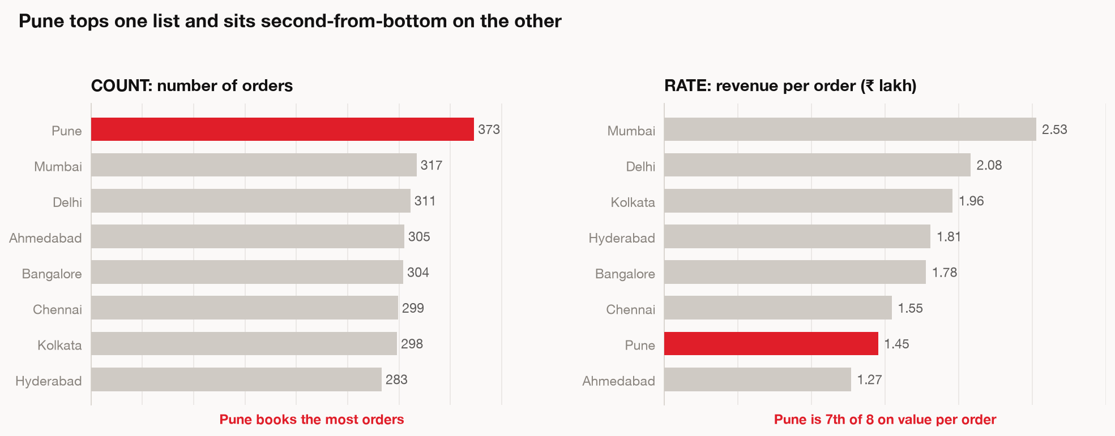
DISTORTION 1 — COUNTS WHERE RATES BELONG
MODULE 4 · THE SIX DISTORTIONS
41

Slide 42
MODULE 4 · THE SIX DISTORTIONS
Always ask “per what?”
Counts reward whoever is biggest. Divide by something and you find out who is actually good at it. Per order, per rep, per rupee spent, per head.
42

Slide 43
DISTORTION 2 — THE MEAN QUOTED AS TYPICAL
MODULE 4 · THE SIX DISTORTIONS
43

Slide 44
MODULE 4 · THE SIX DISTORTIONS
Mean, median, and the gap between them
Read the gap before you quote either
WHAT IT IS
WHEN TO USE IT
Mean
Add everything up, divide by the count
Values cluster together with no long tail
Median
Line them up, take the one in the middle
A few large values are pulling the average
The gap
₹1.80L mean against ₹0.79L median
At 2.3× apart, quoting the mean overstates
44

Slide 45
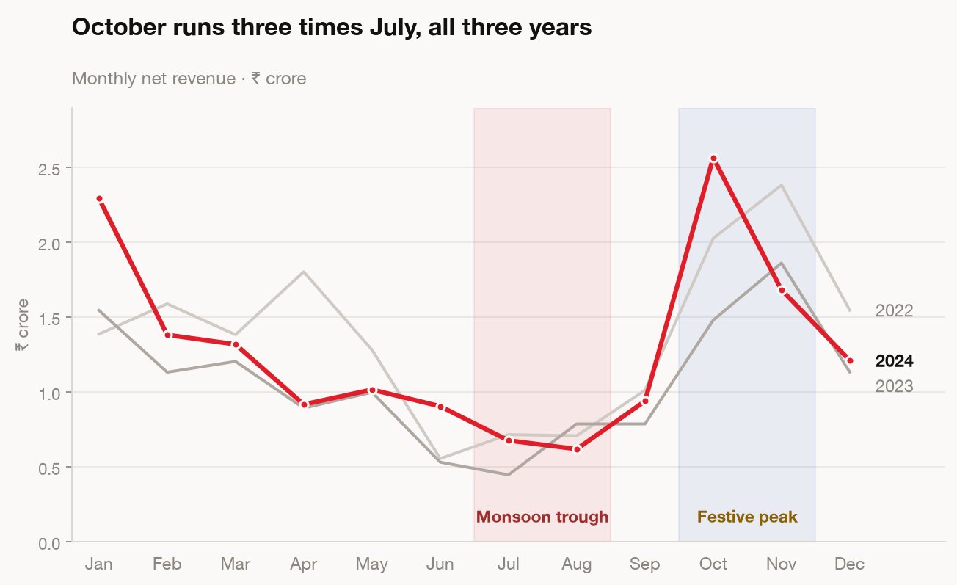
DISTORTION 3 — CALENDAR READ AS PERFORMANCE
MODULE 4 · THE SIX DISTORTIONS
45

Slide 46
MODULE 4 · THE SIX DISTORTIONS
Which growth comparison to use
This file swings threefold between July and October, so a month-on-month number here is mostly calendar.
1
Year on year
This January against last January. Cancels seasonality. Your default.
2
Month on month
Fast signal, very noisy. Never multiply it by 12 to get an annual rate.
3
A part-finished month
Exclude it, or put the day count right next to the number.
46

Slide 47
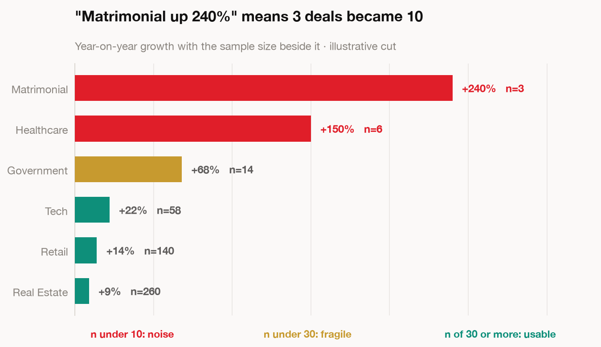
DISTORTION 4 — PERCENTAGES ON TINY SAMPLES
MODULE 4 · THE SIX DISTORTIONS
47

Slide 48
MODULE 4 · THE SIX DISTORTIONS
Distortion 5 — correlation reported as cause
Two series moving together is the beginning of the work, not the end
Ice cream sales and drowning deaths rise together.
Summer drives both.
SO WHEN YOU FIND A RELATIONSHIP
Ask what else changed in the same window
Campaigns, pricing, seasonality, a tracking change.
Say out loud whether you observed it or inferred it
Two words. It changes how the room treats the claim.
Go looking for the third thing driving both
That is usually where the actual explanation is.
48

Slide 49
MODULE 4 · THE SIX DISTORTIONS
WAR STORY · HT DIGITAL STREAMS · PLATFORM CONSOLIDATION
Three tools, three versions of the same metric.
₹2.5 Cr
a year in run-rate savings once the duplicate stack was retired
Mixpanel, Redshift and Elasticsearch each held a version of the truth, and teams quoted whichever one they had access to. Meetings were spent reconciling numbers rather than deciding anything.
Consolidating onto one modelled layer with agreed definitions took most of six months. The reporting improvement was almost a side effect.
Distortion 6 is the undefined metric. It is the cheapest one to fix and the one nobody owns.
49

Slide 50
MODULE 5 · THE FIVE-CHECK GATE
MODULE 5 OF 5
05
The Five-Check Gate
Aurex will run your code perfectly and still answer
the wrong question. This is the gate before you send.
15 MINUTES
50

Slide 51
MODULE 5 · THE FIVE-CHECK GATE
A groupby on the wrong column runs perfectly
Nothing in the output tells you the column was wrong
You get a clean table, a tidy chart and a confident summary. The failure mode moved from arithmetic to aim.
MEASURED ACCURACY ON REAL SPREADSHEETS
Looking things up
Filtering rows
Adding things up
89%
71%
54%
Counting
Sorting
Medians
42%
38%
20%
Lookups come back right. Anything that needs arithmetic across rows, check it yourself.
51

Slide 52
MODULE 5 · THE FIVE-CHECK GATE
The Five-Check Gate
94% of working spreadsheets already carry a human error. The bar here is checkability, not perfection.
1
Row accounting
Ask how many rows it used, then compare that to how many are in the file.
2
Spot-verify the headline
Pick the number that matters most and check that one against the source.
3
Ask it a second way
Different phrasing, same question. Two answers means you have none.
4
Open what it made you
Look at the axis. Read the labels. Generated files look finished early.
5
Sign it
Would you put your name on this? You are about to.
52

Slide 53
MODULE 5 · THE FIVE-CHECK GATE
HANDS-ON · 10 MIN
Take the finding you produced earlier.
Run all five checks against it.
Rewrite it as one sentence your manager could act on.
Post in chat: “Your one sentence”
53

Slide 54
The five cards you are leaving with
Each one works on any file, in any tool, in any department
01
THE SEVEN-STEP READ
Context · Shape · Total · Break down · Compare · Drivers · Validate
02
THE EIGHT LENSES
Comparison · Ranking · Trend · Composition · Distribution · Correlation · Outliers · Decomposition
03
THE CHART SELECTOR
Name the comparison, take the chart it gives you
04
THE SIX DISTORTIONS
Rates · Mean · Calendar · Sample size · Cause · Definitions
05
THE FIVE-CHECK GATE
Rows · Headline · Second phrasing · Open the file · Sign it
54

Slide 55
Somebody sends you a spreadsheet you did not build,
about a part of the business you half-know,
and wants your read on it by tomorrow morning.
You now have a sequence for that.
Dishant Singla · Base42 Systems · run on Aurex, inside BCCL
55

